Slide 1


DECISION TREES IN ACADEMIC SUCCES IN SABER PRO

Slide 2






Team Presentation
Santiago
Ochoa
Miguel Angel
Zapata
Miguel Correa
Mauricio
Toro
http://github.com/ /proyecto/
sochoac1

Slide 3
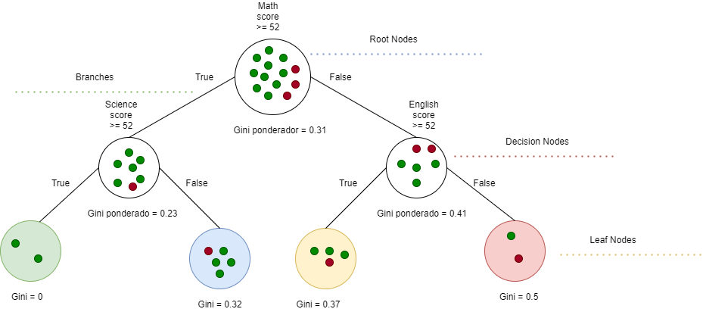

Algorithm Design
To build a binary tree the algorithm implemented was CART. In this example, we show a model to predict the academic success as the probability that a student must get a score above the average in the Saber pro.

Slide 4
Node Splitting
The green circles represent the student above the average and the blue circle represent the students below the average
This split is an example of how the algorithm works identifying the Gini impurity of each node. The condition stablished is "Science score >= 52". At the time of find the Gini impurities for this case, left Gini is 0 , right Gini is 0.32 and weighted Gini is 0.23.
This is another example of splitting. In this case the condition that determinate how the data will be distributed is "Englis score >= 52". The left node have produced a Gini impurity of 0.37, the right node impurity is 0.5 and the weighted Gini is 0.41

Slide 5

Complete this slide
For the third deliverable
Algorithm Complexity
Keep this title
Create the table in Powerpoint. Do not copy pixelated screenshots from the technical report please!
 | Time Complexity | Memory Complexity
Training the model | O(N²*M*2^{M}) | O(N*M*2^{M})
Testing the Model | O(N*M) | O(1)
Time and memory complexity of the (In this semester, one could be CART, ID3, C4.5… please choose) algorithm. (Please explain what do N and M mean in this problem. PLEASE DO IT!
Explain the tables in your
own words
Include another HD picture related to the example that you modeled in the decision tree

Slide 6
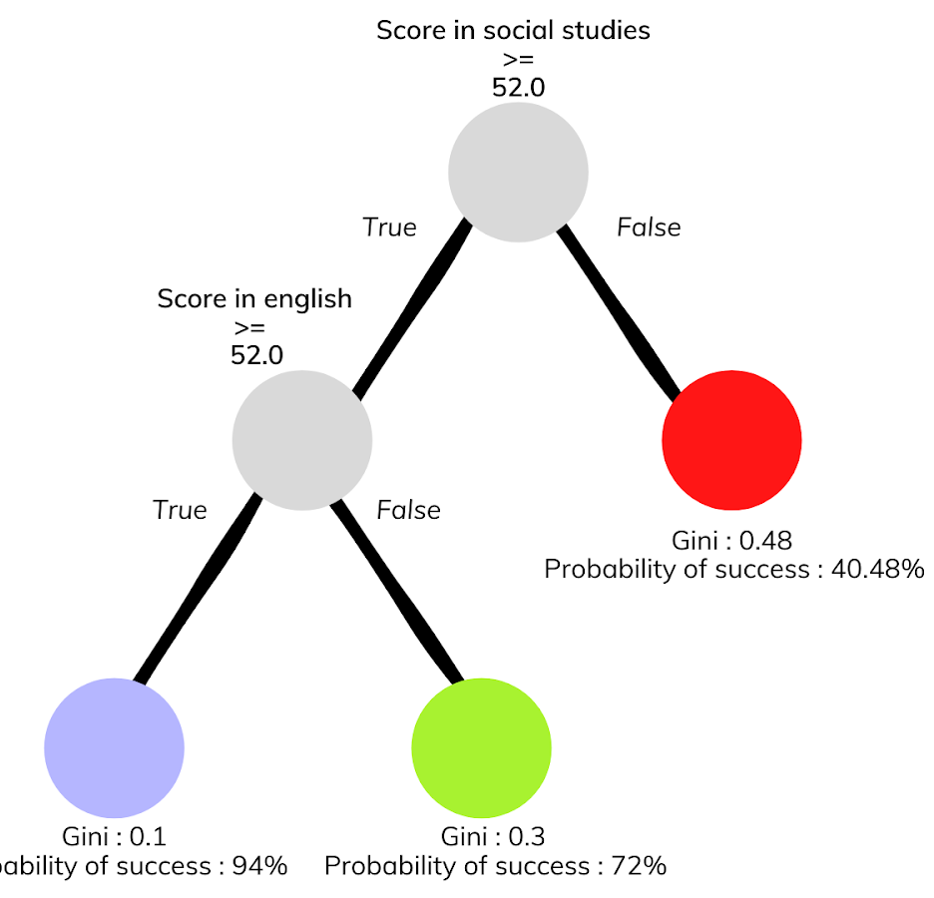



Complete this slide
For the third deliverable
Decision-Tree Model
Keep this title
Create the Figure in Powerpoint. Do not copy pixelated screenshots from the technical report please!
Most Relevant Features
Social Studies
English
Gender
A binary decision tree to predict Saber Pro scores based on the results of Saber 11. Violet nodes represent those with a high probability of success, green medium probability and red a low probability of success.
Use an icon for each feature!
Is it ethical to make a model that predicts academic success based on gender?
Explain the Figures in your
own words

Slide 7
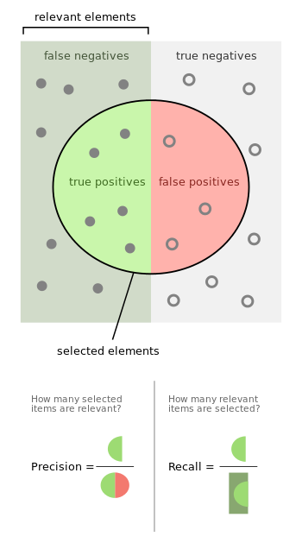
Complete this slide
For the third deliverable
Evaluation Metrics
Keep this title
Use vectorized figures to
explain the algorithm the evaluation metrics, so they are not pixeled like mines
Use these
Colors for
Your figures
Explain Accuracy too…
In the same manner
If possible, avoid equations for simple concepts that can be
explained through diagrams

Slide 8

Complete this slide
For the third deliverable
Evaluation Metrics
Keep this title
Create the table in Powerpoint. Do not copy pixelated screenshots from the technical report please!
 | Training data set | Testing data set
Accuracy | 0.8 | 0.62
Precision | 0.6 | 0.55
Recall | 0.76 | 0.61
Evaluation metrics using a training dataset of 135,000 students and test dataset of 45,000 students.
Include another HD picture related to the example that you modeled in the decision tree
Explain the tables in your
own words

Slide 9


Complete this slide
For the third deliverable
Time and Memory Consumption
Keep this title
Create the plots in Excel. Do not copy pixelated screenshots from the technical report please!
Time Consumption
Memory Consumption

Slide 10
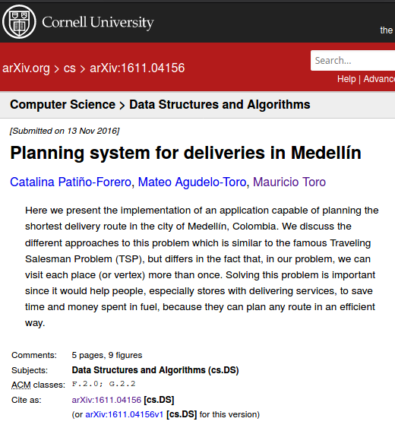
Complete this slide
For the third deliverable
Report Accepted on arXiv
Keep this title
Include the citation of the report in arXiv and link
C. Patiño-Forero, M. Agudelo-Toro, and M. Toro. Planning system for deliveries in Medellín. ArXiv e-prints, Nov. 2016. Available at: https://arxiv.org/abs/1611.04156
Include a screenshot

Slide 11
Complete this slide
For the third deliverable
Say thank you for listening!
THANK YOU!

